Slide 1
COVID and insolvency
Bratislava
JUDr. Martin Provazník
5th May 2021

Slide 2
What we will talk about
"COVID" legislation and companies' financial problems
Debtor's financial problems: a company "in crisis"
Debtor's financial problems: an insolvent company
Debtor's financial problems: filing for bankruptcy?
Paying debtor and prevention of debtor's insolvency
Paying insolvent debtor
Non-paying debtor
Non-paying insolvent debtor

Slide 3
Fundamental regulations
Commercial Code
Act No. 7/2005 Coll. on bankruptcy and restructuring
Decree No. 643/2005 Coll. laying down details on the method of determining cash-flow insolvency and balance-sheet insolvency
Decree No. 665/2005 Coll. implementing certain provisions of Act No. 7/2005 Coll. on bankruptcy and restructuring

Slide 4
Basic concepts
Company “in crisis”
Insolvency: debtor’s cash-flow insolvency
Insolvency: debtor’s balance-sheet insolvency
Insolvency: insufficient assets to cover the bankruptcy costs

Slide 5
Company in crisis
if the company is bankrupt or threatened with bankruptcy
the threat of bankruptcy, if
consequences: management must seek to avert a crisis
Performance in lieu of own funds (PILF) - 2 definitions:
Loan/similar performance provided to a company in crisis. Also, performance provided before the crisis, if maturity was postponed/extended during the crisis.
Performance provided by a related party (Art. 67c (2) CC)
$$\frac{ownership equity}{payables}<\frac{8}{100}$$
company in crisis
bankruptcy and restructuring
insolvency

Slide 6
Company in crisis
PILF (+accessory and contractual penalty) cannot be recovered during crisis/by providing the company would fall into crisis.
The reimbursed performance must be claimed back by the management (+ management guarantee)
If PILF is secured by a guarantee/lien/other security, the creditor can satisfy itself from the guarantee directly without first having to claim from the company (priority of satisfaction)
company in crisis

Slide 7
Cash-flow insolvency
The inability of a legal entity to meet at least two monetary obligations to more than one creditor 30 days past due.
Consequence: the creditor is entitled to file for bankruptcy
Creditor's petition to declare bankruptcy on the debtor's assets: (i) petition, (ii) written demand for payment, (iii) identify the other creditor, (iv) prove the claim (e.g. court decision, auditor's certificate), (v) advance payment of €1,500 (group of 5+ employees is exempt)
The debtor either (i) certifies solvency, or (ii) certifies that the claims are disputable, or (iii) pays, (iv) otherwise the court will declare bankruptcy
Cash-flow insolvency

Slide 8
Balance-sheet insolvency
Balance-sheet insolvency = (i) is required to keep accounts, (ii) has more than one creditor, and (iii) the value of its liabilities exceeds the value of its assets (not counting subordinated liabilities or liabilities with regard to a related party).
Consequence: the debtor is required to file for bankruptcy within 30 days of when it became aware or, with the exercise of due diligence, could have become aware of its balance-sheet insolvency.
$$liabilites−subordinated liabilties−related party liabilities >assets$$
balance-sheet insolvency

Slide 9
Insufficient assets to cover bankruptcy costs
Insufficient assets to cover the costs of the bankruptcy = less than EUR 6,500
After the bankruptcy petition is filed and insufficient assets, the bankruptcy is dismissed and the debtor is deleted from the commercial register
management may be held liable for the company's debts
Company in crisis
insolvency
EUR 6,500

Slide 10
Creditor: when the debtor pays
Challengeable legal acts are: without adequate consideration (gratuitous alienation)/preference given to a creditor/defrauding creditors
Preference given to a creditor if: (i) the debtor has preferred in whole or in part a monetary claim otherwise payable only by filing for bankruptcy, (ii) has secured its obligation later than the obligation has arisen, (iii) has agreed to modify or to replace its obligation to its disadvantage, or (iv) has otherwise unreasonably favored one creditor over other creditors, (v) the debtor has wholly or partly waived its right/forgiven its debtor's debt/arranged for the modification or replacement of its right to its disadvantage/arranged for or otherwise allowed its right to cease/otherwise unreasonably disadvantaged itself to at the expense of its creditors.
debtor’s challengeable legal acts

Slide 11
Creditor: when the debtor does not pay
Filing a legal action / for payment order – electronic procedure (6% and 3% fee)
Securing measures
Creditor's petition to declare bankruptcy on the debtor's assets: debtor can certify its solvency/certify the disputability of claims/pay the claims/bankruptcy
Penalty EUR 12,500
Management’s liability: legal fiction regarding the amount of damage (100% of the outstanding claims), legal fiction regarding the occurrence of a loss event, statute of limitations 1 year
securing measures
Management’s liability
payment order
bankruptcy petition

Slide 12
Creditor: when the debtor does not pay
Management’s liability also if: (i) failure to file for bankruptcy in time, but the bankruptcy is not stopped due to lack of assets (no fictions apply), (ii) enforcement stopped, (iii) failure to deposit a declaration on its solvency in the register of deeds within 30 days of the termination of the temporary protection
A final judgment imposing an obligation to compensate for damages due to a breach of the obligation to file for bankruptcy in time is a disqualification decision (impossibility to act as management/supervisory body member for 3 years)
Management’s liability

Slide 13
Obligations of an insolvent debtor
File for bankruptcy – within 30 days
Failure to file = fine of 12,500 EUR - payment within 15 days of the summons, which if not paid and ordered by the court to pay = disqualification decision (may not act as a management/supervisory body member for 3 years)
Failure to file + lack of assets = fine + liability (failure to pay = disqualification decision)
Debtor’s protection after filing for bankruptcy (effects of bankruptcy proceedings initiated, in particular impossibility to start enforcement, enforcement proceedings are suspended)
File for bankruptcy

Slide 14
Help with the aftermath of the COVID pandemic
Multiple types of assistance (e.g. financial assistance from the state or rent subsidy)
Must not be an undertaking experiencing difficulties
SME must not be in bankruptcy and
Different equations for other types of companies
Mostly declaration "I am not in bankruptcy, restructuring, liquidation, or under administration, and I have no repayment plan (7/2005)"
$$ownership equity>accumulated loss$$
bankruptcy and restructuring
€
€
€ ?

Slide 15
Help with the aftermath of the COVID pandemic
Temporary protection
Act No. 421/2020 Coll. on temporary protection of entrepreneurs in financial difficulties
Application to court, formal procedure, consent of 51% of creditors
The applicant is not obliged to file for bankruptcy, the enforcement procedures on the company's assets are ceased
Effects: cannot be decided on opening of insolvency proceedings, cannot seize undertaking’s assets in an enforcement procedure
Obligation to give priority to the common interest of creditors
Extendable for 3 months
After expiry of temporary protection - bankruptcy/solvency declaration
Temporary protection

Slide 16
Some "COVID" regulations
Act No. 421/2020 Coll. on temporary protection of entrepreneurs in financial difficulties
Act No 67/2020 Coll. on certain emergency measures in the financial sector in connection with the spread of the dangerous contagious human disease COVID-19
Act No 62/2020 Coll. on certain emergency measures in connection with the spread of the dangerous contagious human disease COVID-19 in the judiciary

Slide 17
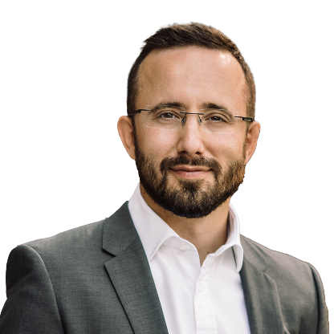
Contact
Martin Provazník is a partner at bpv BRAUN PARTNERS in Bratislava. He specializes primarily in dispute resolution, corporate law, insolvency and restructuring. Other practice areas include information technologies and communication, intellectual property, white collar crime, international relations and EU law. He represents a wide range of clients, from individuals to multinational corporations.
Languages
Slovak, English, German
Education
Faculty of Law at Trnava University in Trnava, Slovakia (JUDr. 2007, Mgr. 2005)
Work experience
Since 2021 bpv Braun Partners
2018 – 2021 associated partner, bnt attorneys in CEE 2008 - 2017
2005 - 2008 junior associate, bnt attorneys in CEE
2003 - 2004 legal assistant, Wüstenrot stavebná sporiteľňa, a.s.
Miscellaneous
Member of the Slovak Bar Association
Member of INSOL Europe
Member of VIAC (Vienna International Arbitral Centre)
Member of YAAP (Young Austrian Arbitration Practitioners)
Active in "Advokáti Pro Bono" (a project organized by the nonprofit Nadácia Pontis)
Special acknowledgment in the Via Bona Awards for helping with a systematic change in personal bankruptcies and debt-free regime in Slovakia (2016)
Selected publications
Martin Provazník: Company mergers in Slovakia where the legal successors are in bankruptcy or restructuring (sk), (2012-2019)
JUDr. Martin Provazník
Partner
Contact:
bpv BRAUN PARTNERS s.r.o., o.z. Europeum Business Center Suché mýto 1 SK-811 03 Bratislava
Tel: +421 233 888 880
Fax:+420 220 910 844
e-mail: martin.provaznik@bpv-bp.com

Slide 18
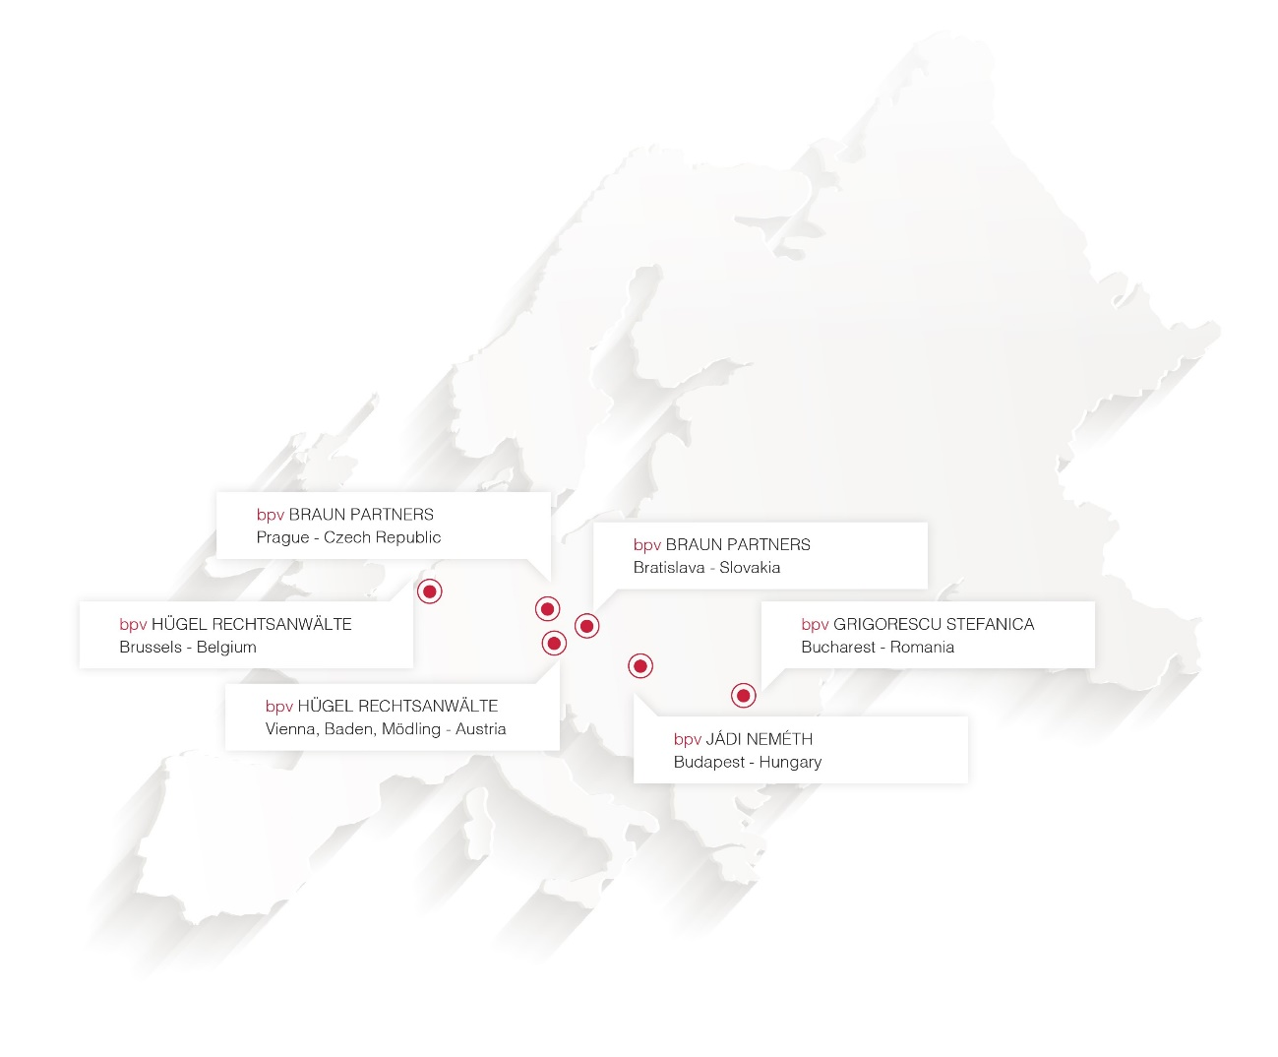
About bpv BRAUN PARTNERS / bpv LEGAL
The core of the bpv BRAUN PARTNERS team has been together since 1994, originally as part of a leading international law and tax firm of German origin (Haarmann Hemmelrath). Our lawyers and tax advisers have supported hundreds of western clients in their first steps in the Czech Republic and Slovakia, and we are grateful that we can continue the cooperation with many of these clients to this day.
Our advisory work includes not only advising on significant transactions, and therefore making the newspaper headlines, but also finding the solution to business problems in everyday life. Beginning with the construction of a new production, service location or sales structure, our aim is always to achieve the business goals of our clients together.
Our clients are entrepreneurs like us – we advise them to the highest possible standards not only because we are professionals, but also because we ourselves think like business owners.
We combine the advantages of an international full service law firm such as know-how, professional employees, international network and continuous training with the flexibility, service orientation and knowledge of the national market of a local law firm. Together with our friends from bpv LEGAL we cover the entire CEE region. bpv LEGAL is a co-operation of four independent law firms in CEE. Founded in 2006 with currently over 140 lawyers

